Slide 1
Operational Performance Review – Chocolate Factory Inc.
By Gbadebo Prevail
(Portfolio Project May, 2025)

Slide 2
Table of contents
01
02
03
04
05
06
Objective & Tools
Business Context & Dataset
Sales & Customer Insights
Cost & Margin Analysis
Factory & Fulfillment Gaps
Root Causes (Visual)

Slide 3
Table of contents
07
08
09
Strategic Recommendations
Project Impact
Thank You/Contact

Slide 4

01
Objectives
of the project

Slide 5
Objectives
Our aim
The goal
To analyze and optimize the operational performance of Chocolate Factory Inc. by identifying inefficiencies across sales, cost, and fulfillment systems.
Improve shipping speed and cost-efficiency
Streamline SKU and inventory management
Increase customer retention and sales performance
Enhance overall supply chain agility through analytics

Slide 6
Tools Used
SQL (BigQuery)
Python
Looker Studio
BigQuery ML
SQL (BigQuery) was used extensively for data preparation, including cleaning, transformation, and calculation of key metrics like shipping delay, profit margin, and product segmentation.
Python supported additional data engineering tasks, such as reverse geocoding factory coordinates to derive city names and building custom features.
Looker Studio was used to create dynamic dashboards that visualized trends in sales, shipping performance, customer engagement, and cost metrics.
BigQuery ML was employed to build a predictive model for sales and fulfillment delays. The model achieved strong accuracy (R² = 0.81), supporting scenario analysis and data-driven recommendations.

Slide 7
02
Business Context

Slide 8

Company Overview
Chocolate Factory Inc. is a mid-sized confectionery company operating across five regional factories with three primary product divisions: Chocolate, Sugar-based confections, and Novelty items. Serving over 5,000 customers, the company has strong brand recognition but is currently facing significant operational challenges. These include a 43.5% year-over-year decline in sales, an average shipping delay of 3.96 days, and inefficiencies stemming from SKU proliferation and uneven factory utilization. These issues have increased cost pressures and reduced overall supply chain responsiveness.

Slide 9
03
Sales & Customer Insights

Slide 10
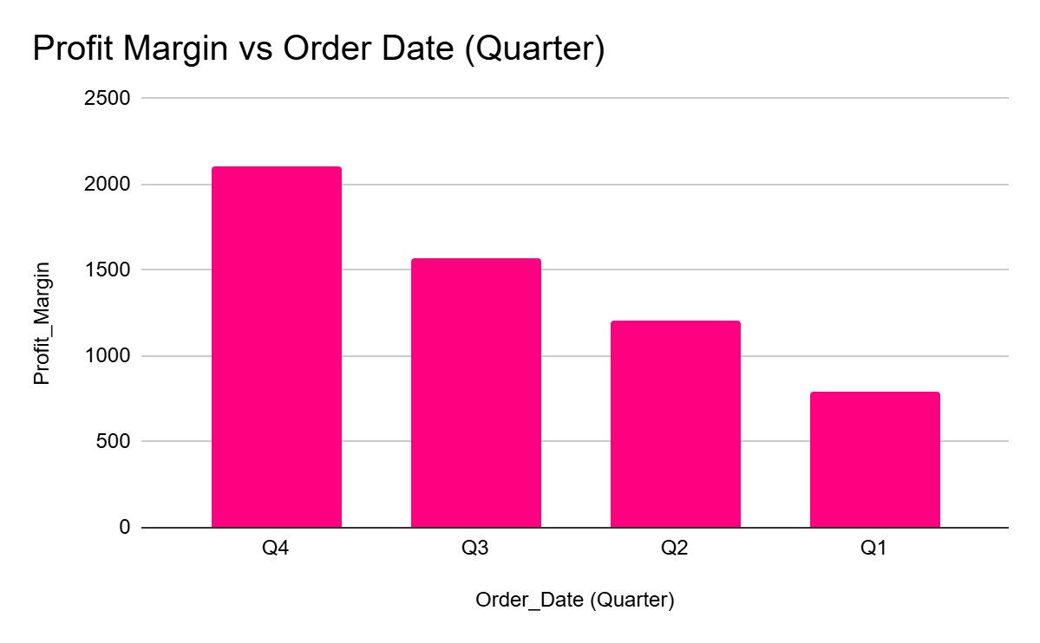
>125k
Total Sales
0.7
Avg. Profit Margin

Slide 11
Sales & Customer Insights
Key Patterns
Strategic Implications
Seasonal peaks in Q4 and Summer drive up unit sales and price elasticity
74.4% of customers have not purchased in over 365 days
Only 6.7% are active within the last 90 days → steep drop-off post-purchase
Top revenue contributors experience long fulfillment delays, especially during holidays
Rolling sales behavior shows inconsistent repurchase patterns, even among high spender
Opportunity to launch recency-based loyalty programs (e.g., offers for <180-day segments)
Use delivery performance as a loyalty lever—prioritize fulfillment for top-value cohorts
Consider bundle reactivation campaigns during peak seasons to shorten purchase gaps
Introduce post-purchase engagement triggers to drive repurchase within 90-day window

Slide 12
04
Cost & Margin Analysis

Slide 13
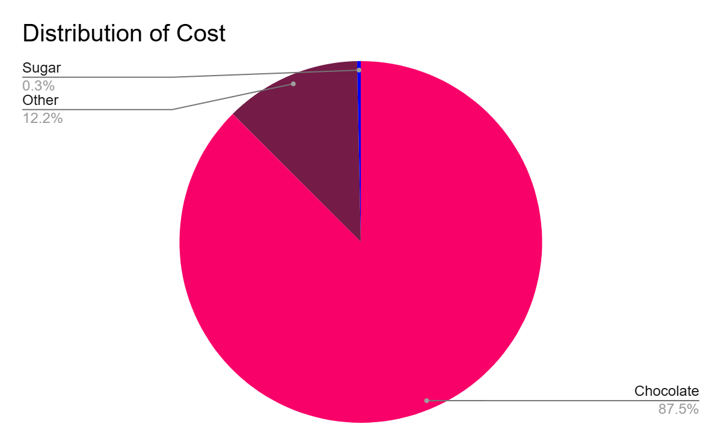
Chocolate
Other
Sugar
>43k
Total Cost

Slide 14
Cost & Margin Analysis
Key Patterns
Strategic Implications
Average gross margin: $9.68 per unit
80% of SKUs fall below the average margin threshold of 0.70
Top 15% of products generate over 80% of sales and margin—strong ABC skew
First-Class shipping is the most expensive mode and delivers poor ROI due to long delays
Novelty SKUs (e.g., Kazookles, Fun Dip) carry high per-unit cost with minimal contribution
Rationalize low-margin SKUs to reduce overhead and improve product mix efficiency
Shift First-Class volume to Same Day or blended modes for high-margin items only
Leverage ABC/XYZ segmentation to inform both margin strategy and fulfillment logic
Align cost-to-serve visibility with pricing and bundling decisions.

Slide 15
05
Factory & Fulfillment Gaps

Slide 16
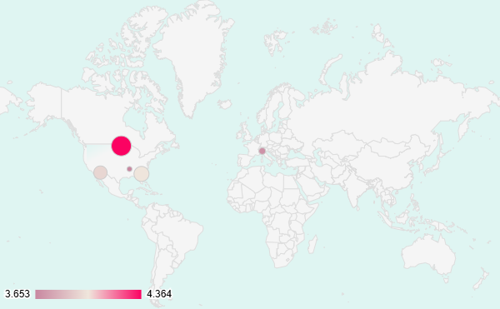
Distribution of Factory Delay
3
Average Delay Days
>34k
Units Sold

Slide 17
Cost & Margin Analysis
Key Patterns
Strategic Implications
Lot’s O’ Nuts and Wicked Choccy’s show high output but rising per-unit cost
Sugar Shack operates at low throughput with one of the highest cost per unit
Casa Grande → NYC lane has 1,770 delayed units—largest single shipping delay
Seasonal demand surges (Q4/Summer) overstress factory capacity
Regional mismatch: Factories often not aligned with their highest-demand zones
Rebalance production by shifting volume to underutilized, cost-efficient factories
Use zone-based routing logic to reduce transit times and streamline costs
Introduce pull-based production (Kanban, SMED) to reduce lead time and improve agility
Integrate capacity data into S&OP to prevent bottlenecks during peak seasons

Slide 18
06
Root Cause Categories & Key Issues

Slide 19
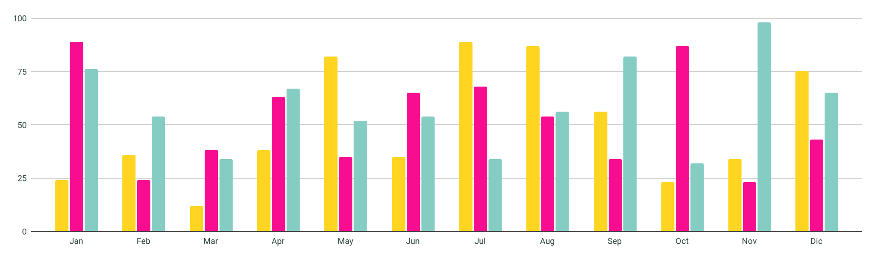
KPI dashboard
Cost
Sales
Units
Highest in December
Peaked in Q4
Highest in November

Slide 20
Root Cause Categories & Key Issues
Factory Capacity
Shipping & Fulfillment
SKU Complexity
Throughput imbalances across production sites
Underutilization of Sugar Shack and The Other Factory
Overload at Lot’s O’ Nuts and Wicked Choccy’s during peak demand
Lack of cross-factory production flexibility
Static shipping mode assignment (e.g., First-Class used across all orders)
Long-distance fulfillment from suboptimal factories
High delay concentration in certain lanes (e.g., Casa Grande → NYC)
Inconsistent carrier performance data not feeding into planning
80% of SKUs underperform on margin
Low-volume SKUs inflate warehousing and changeover costs
Packaging variation increases handling time
High SKU churn reduces inventory visibility

Slide 21
Root Cause Categories & Key Issues
S&OP & Planning
Customer Experience
Forecasts not accounting for lead time variability
No closed-loop feedback from delay or demand data
Seasonal spies not fully aligned with factory capacity
Limited integration between marketing, ops, and fulfillment
High-value customers experience the longest delays
Lack of prioritization by CLV or recency
No tiered service levels in fulfillment logic
Infrequent post-purchase engagement or incentives

Slide 22
07
Strategic Recommendations

Slide 23
Strategic Recommendations
SKU Strategy
Fulfillment Optimization
Factory Rebalancing
Rationalize underperforming SKUs using ABC analysis
Prioritize high-margin, high-velocity products in planning and promotion
Reduce packaging variation and changeover frequency for efficiency
Assign shipping modes dynamically based on product margin and urgency
Shift from First-Class to lower-cost alternatives for low-value orders
Prioritize fulfillment of high-CLV and recent customers during peak windows
Reassign volume from high-delay, high-cost factories to underutilized ones
Align regional demand with factory location to reduce transit time
Implement cross-factory load balancing during Q4 and Summer surges

Slide 24
Strategic Recommendations
Planning & Forecasting
Customer Retention
Adopt rolling S&OP with delay and demand feedback loops
Improve demand sensing for seasonal SKUs and campaign-linked products Integrate recency and inventory data into forecast models
Launch recency-based retention campaigns for dormant segments
Create loyalty tiers or subscription models to increase repeat purchase rate
Personalize bundles or offers based on purchase history and margin contribution

Slide 25
08
Project Impact

Slide 26
Projected Impact
Delay Reduction
Margin Uplift
Cost Savings
Estimated 10–15% decrease in average fulfillment time
Shifting volume from delay-heavy factories could reduce delays by up to 0.5 days per order
Smarter mode assignment lowers delivery variability in high-density zones
Rationalizing low-margin SKUs expected to improve average margin by 3–5%
Leaner production and fewer changeovers could recapture $6,000+ annually in gross profit
Focus on A-class SKUs reduces complexity and stabilizes planning cycles
Optimizing shipping modes projected to save $1,100–2,000 annually
Zone-based routing lowers unnecessary carrier and transit costs
Rebalanced factory output improves utilization and reduces waste

Slide 27
Projected Impact
Customer Retention & CLV
Strategic Takeaway
Recency-driven reactivation campaigns could lift repeat purchase rate by 15–20%
Prioritized fulfillment for top-tier customers improves loyalty and LTV
Shorter repurchase gaps drive more predictable demand
These combined interventions transform Chocolate Factory Inc. into a leaner, faster, and more customer-responsive organization, with measurable gains in margin, service quality, and operational agility.

Slide 28
Conclusion
Chocolate Factory Inc. has strong brand value but faces operational challenges that are limiting growth. Delays, cost inefficiencies, and low-performing SKUs are reducing profitability and customer satisfaction.
With focused action on product mix, factory output, shipping logic, and customer retention, the company can improve margins, speed up delivery, and build a more reliable operation.
This is not just a fix—it is a foundation for long-term growth, stronger loyalty, and better performance across the board.

Slide 29
Thanks!
Do you have any questions?
oyebusolagbadebo5@gmail.com
+44 7435941119
https://www.kaggle.com/oyecrafts
Linkedin

